Slide 1


Experiment 3
Delta-Delta Transformer – Ungrounded System
Unbalanced Load
Dr. Norbert Doerry and Dr. John V. Amy Jr.
http://doerry.org/norbert/MarineElectricalPowerSystems/index.htm
© 2024 by Norbert Doerry and John Amy
This work is licensed via: CC BY 4.0 (https://creativecommons.org/)

Slide 2
Schematic
C_{p} = 2.2 µF
R = 1200 Ω
R_{L} = 300 Ω
R_{La} = 200 Ω
R_{lamp} = 450 Ω
R_{lamp}
Common Mode Current Probe
Current Meter (all phases)
Voltage Meter (all phases)

Slide 3
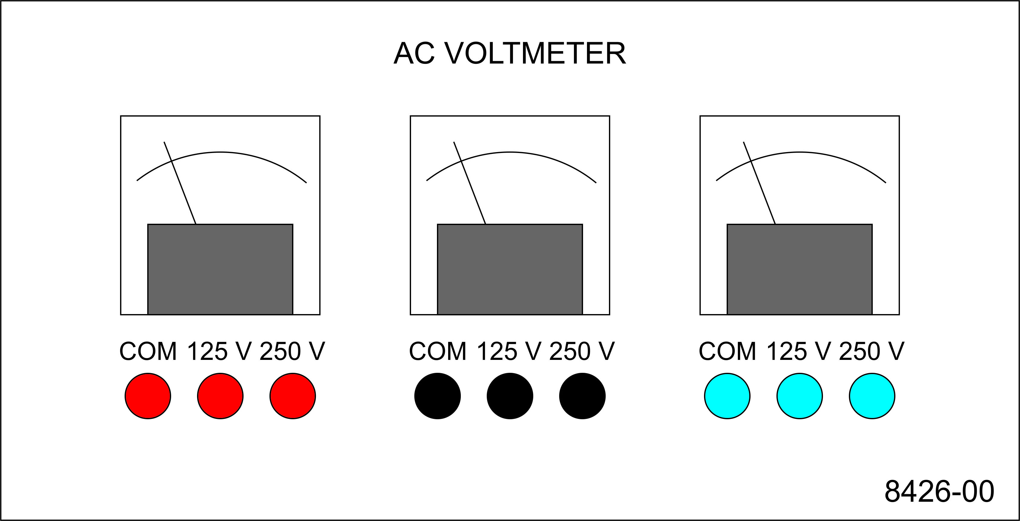
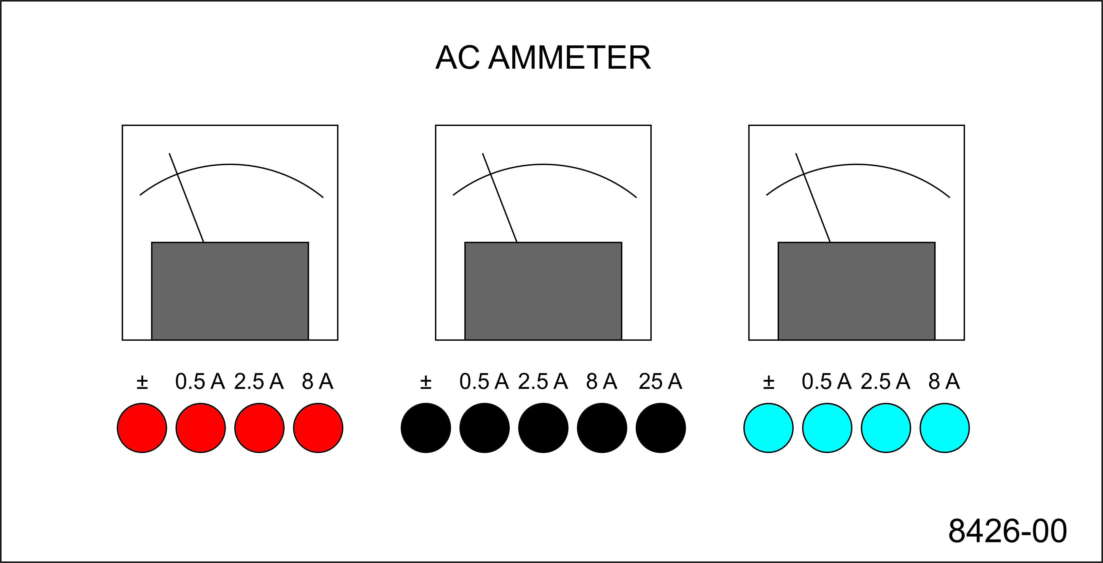
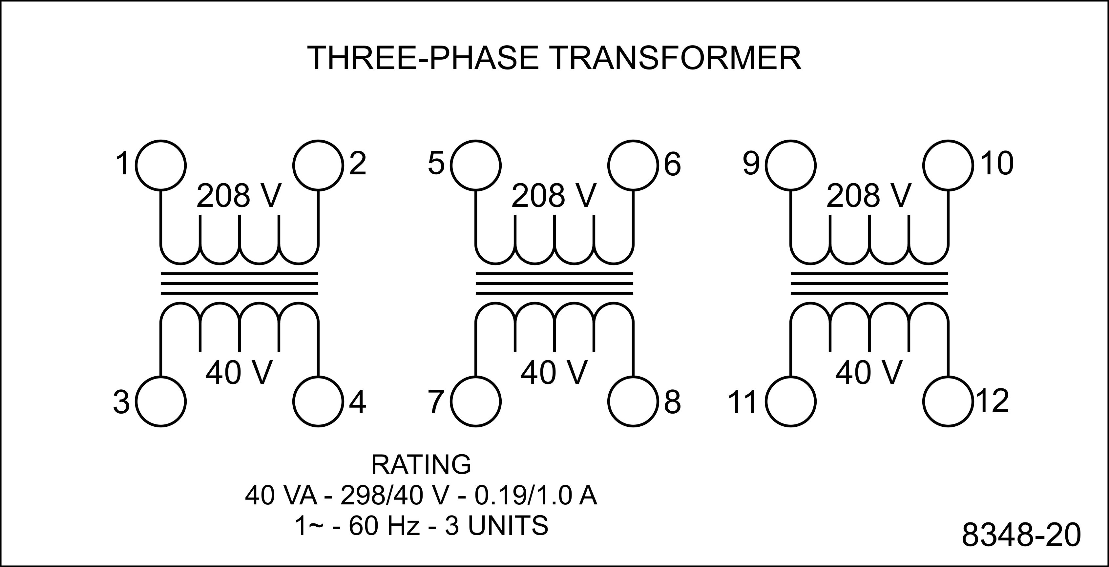
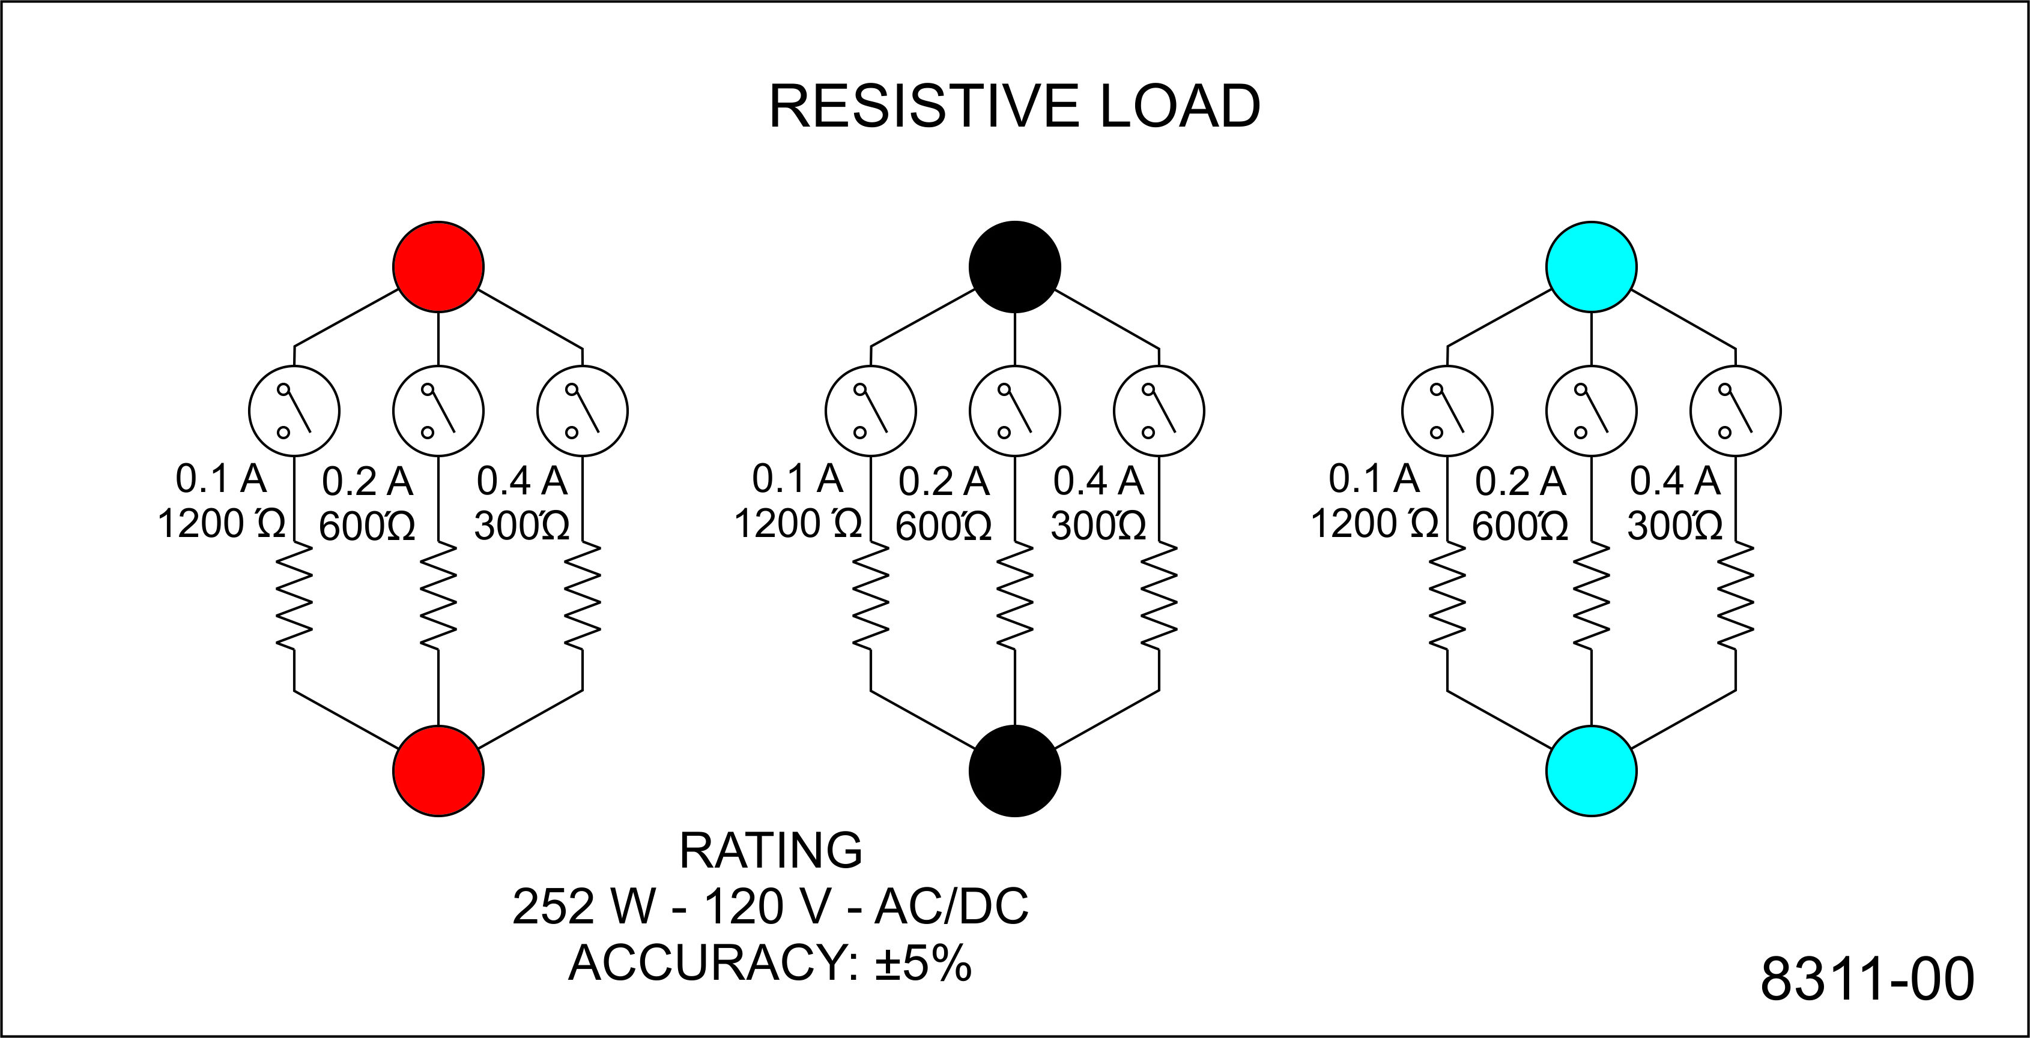
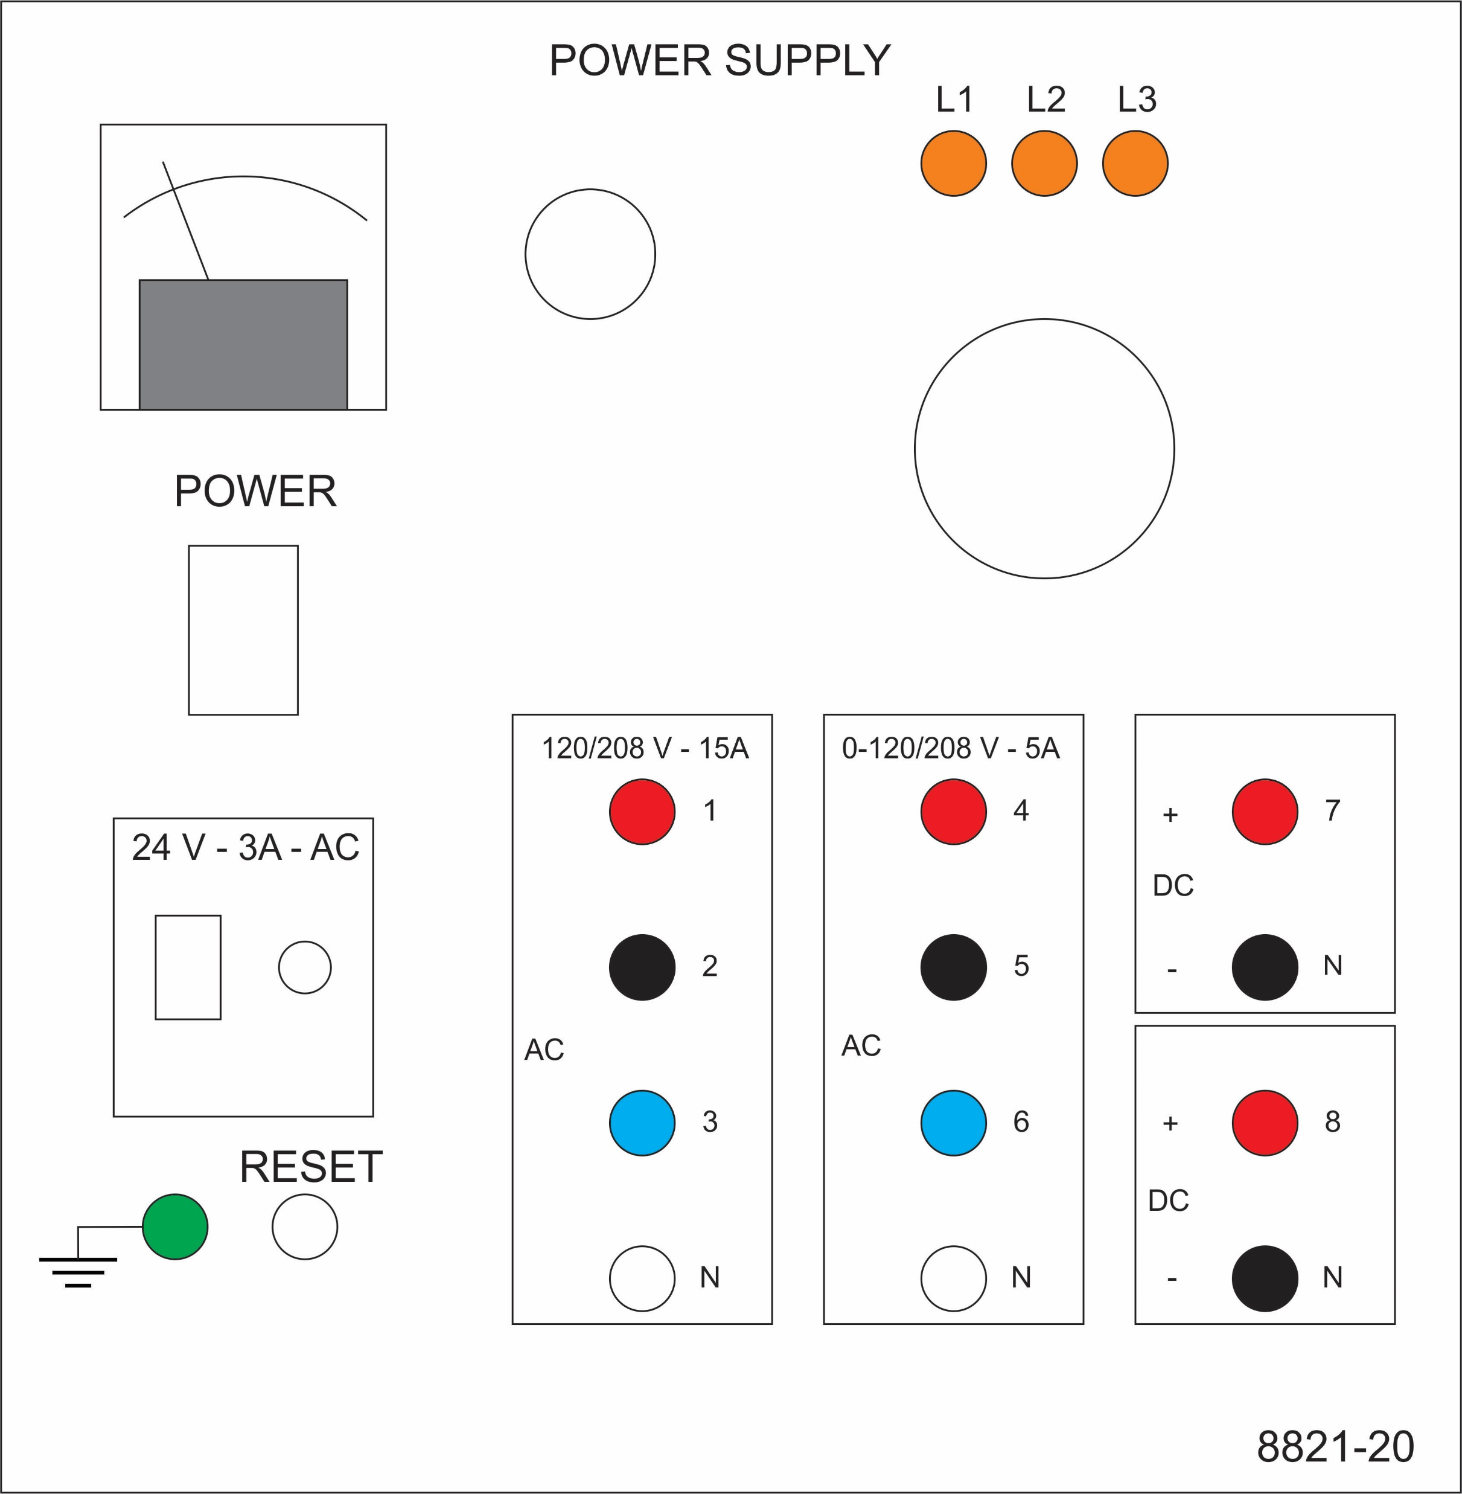
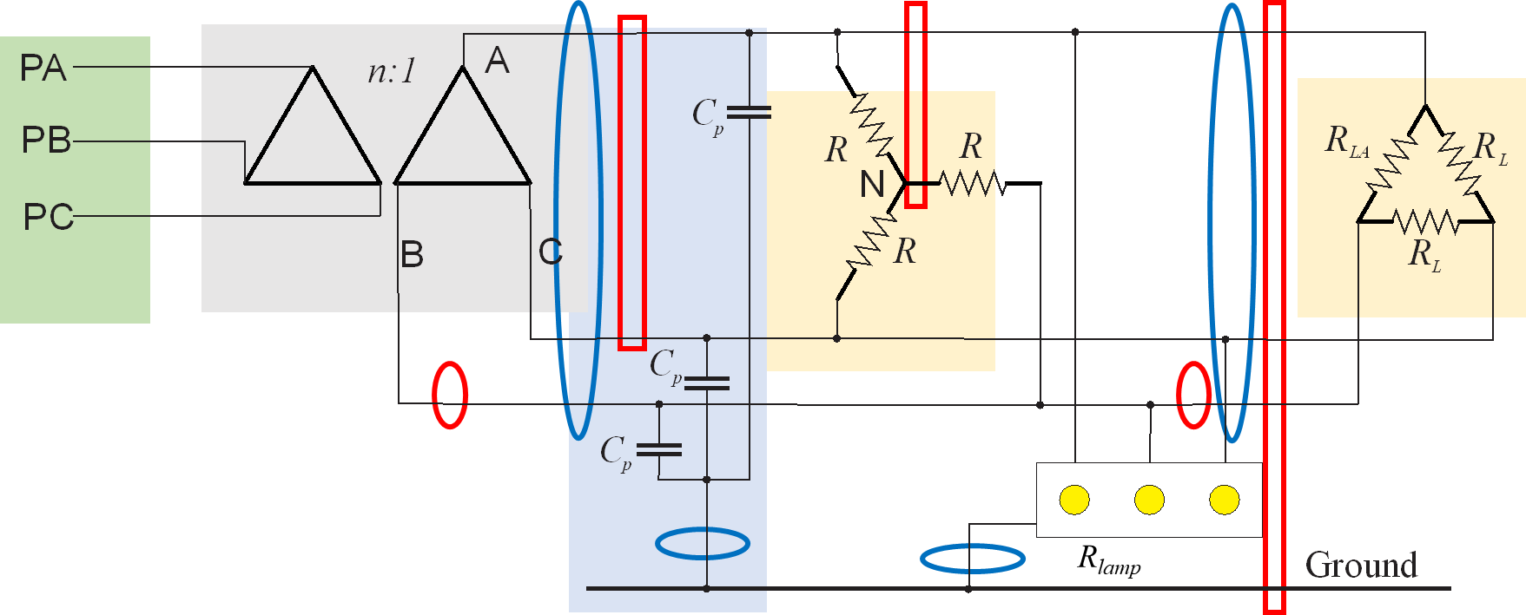
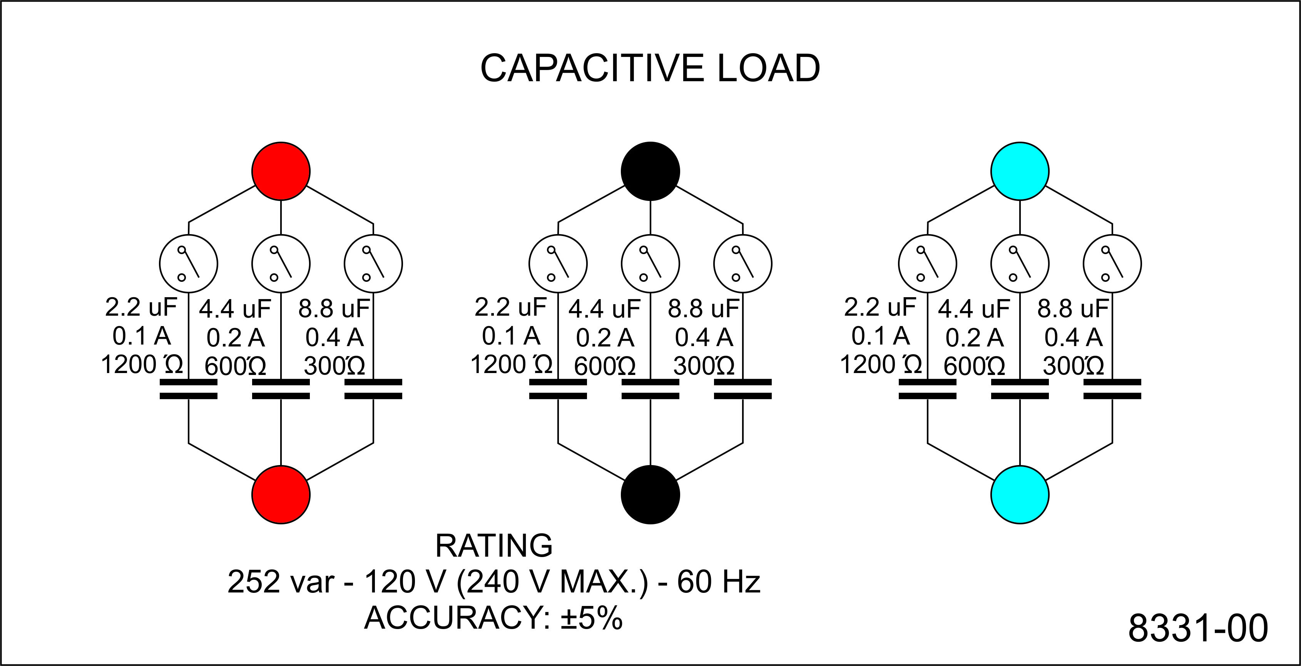
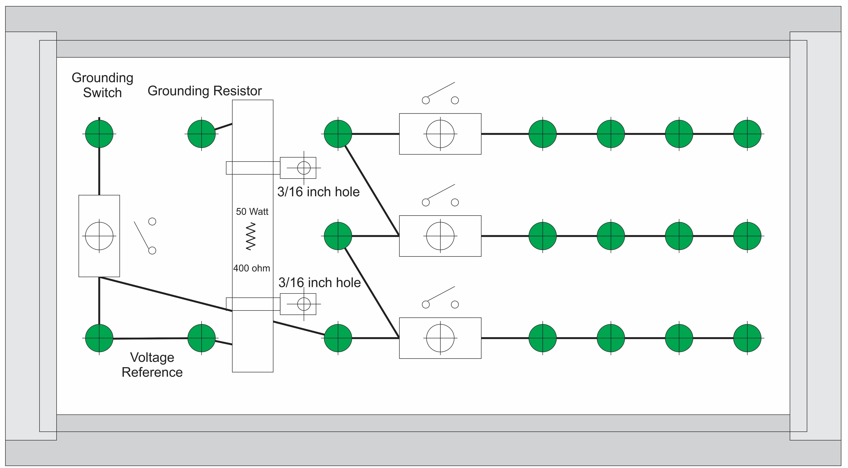
Experiment 3
Secondary - LL
Secondary - LN
Secondary - LG
Transformer line
Load line
Wye
Delta
Parasitic

Slide 4
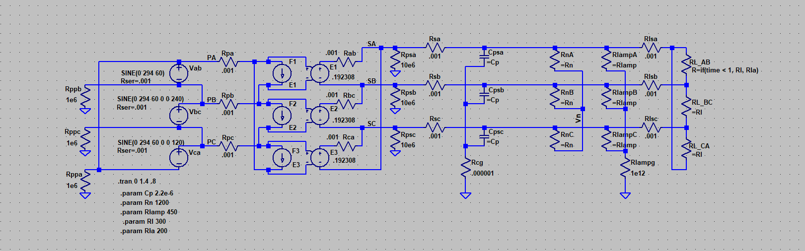
Simulation Model
LTspice
20240810 experiment 3.asc

Slide 5
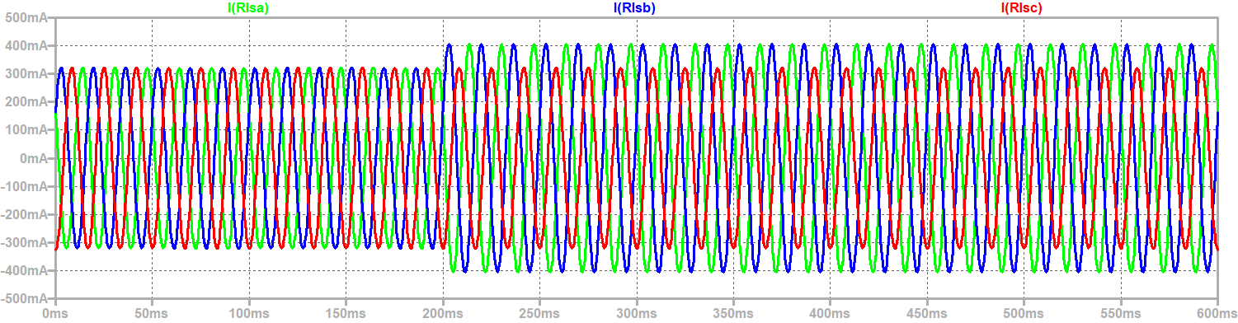
Line currents into the delta load not balanced with unbalanced load
Balanced Load Unbalanced Load

Slide 6
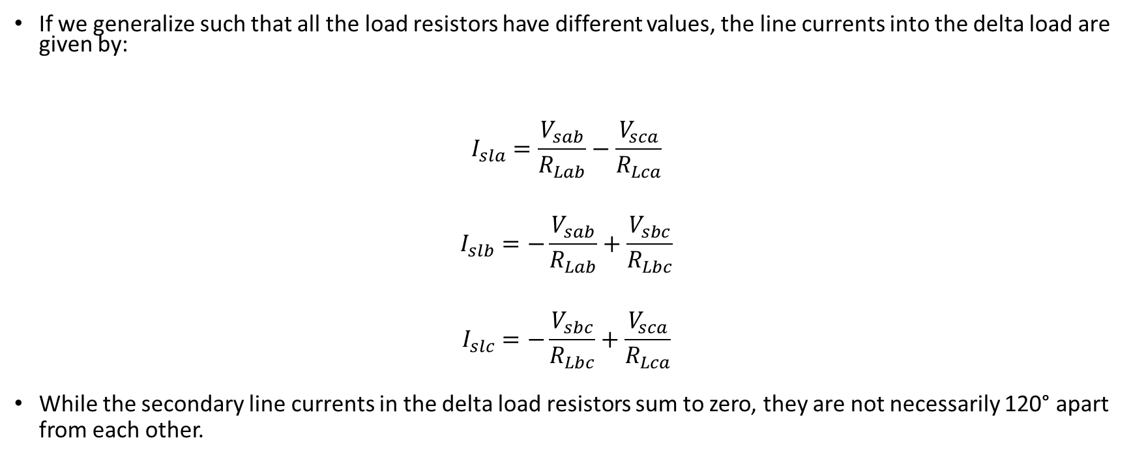
Calculating the secondary line currents into delta load
If we generalize such that all the load resistors have different values, the line currents into the delta load are given by:
$$I_{sla}=\frac{V_{sab}}{R_{Lab}}−\frac{V_{sca}}{R_{Lca}}$$
$$I_{slb}=−\frac{V_{sab}}{R_{Lab}}+\frac{V_{sbc}}{R_{Lbc}}$$
$$I_{slc}=−\frac{V_{sbc}}{R_{Lbc}}+\frac{V_{sca}}{R_{Lca}}$$
While the secondary line currents in the delta load resistors sum to zero, they are not necessarily 120° apart from each other.

Slide 7
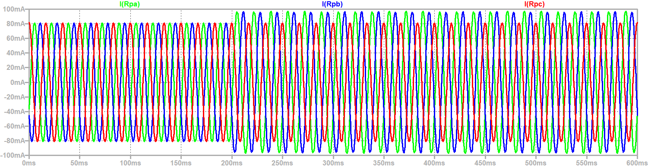
Line Currents on Primary are also not balanced with unbalanced load
Balanced Load Unbalanced Load

Slide 8
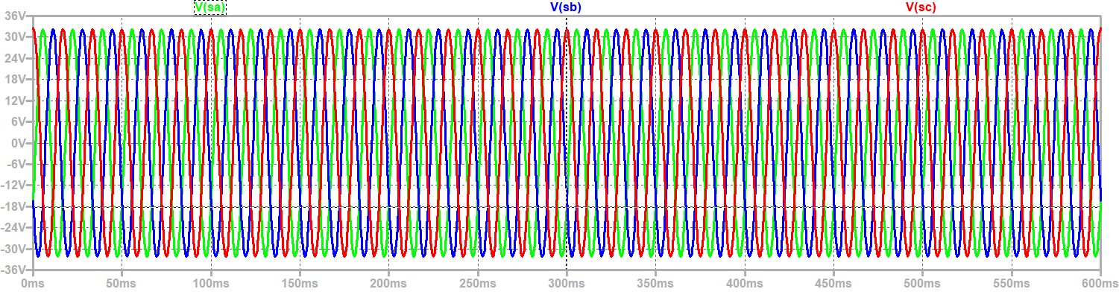
Phase to Ground Voltages are not impacted by unbalanced load
Balanced Load Unbalanced Load

Slide 9
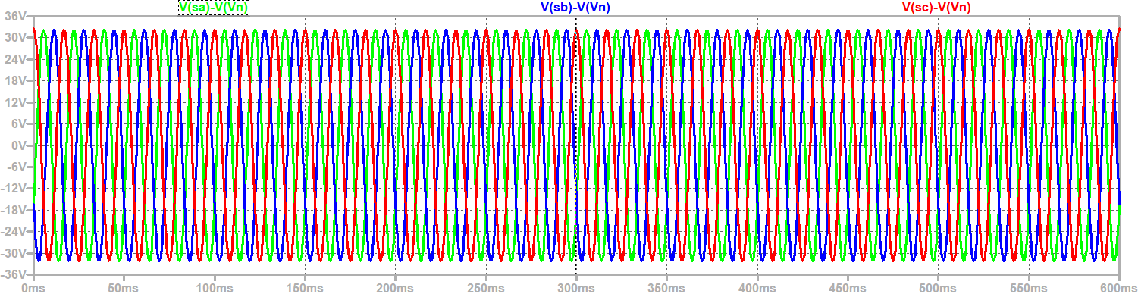
Phase to neutral voltages are not impacted by unbalanced load
Balanced Load Unbalanced Load

Slide 10
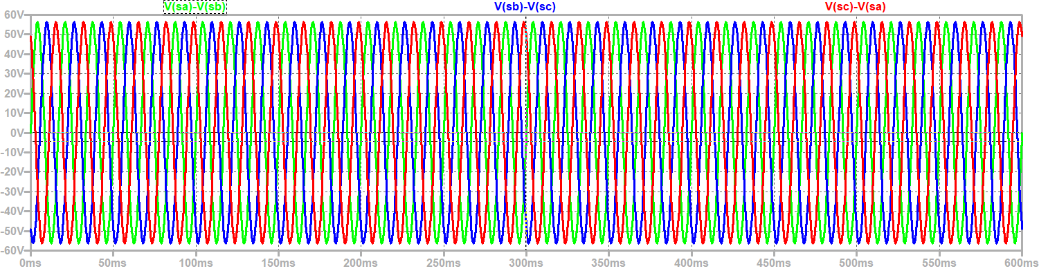
Line to Line voltages are not impacted by unbalanced load
Balanced Load Unbalanced Load

Slide 11
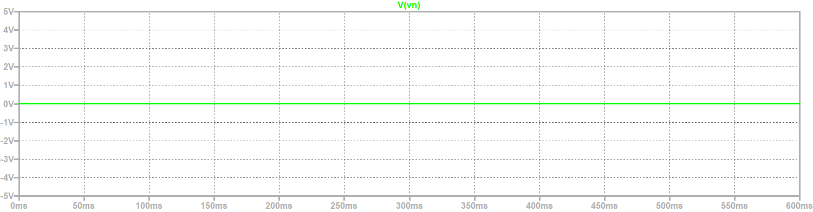
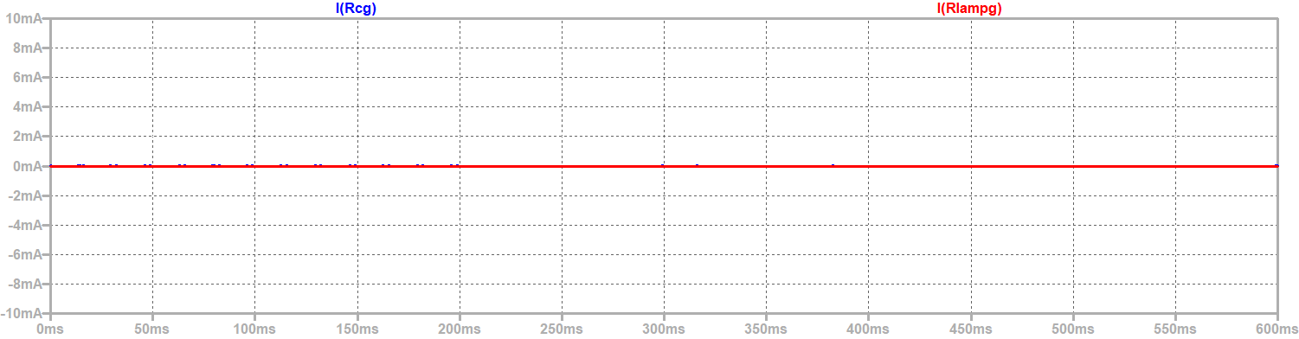
No neutral to ground voltage
(CM Voltage) or CM Current through Parasitic Capacitances or lamp resistances
Neutral to Ground Voltage
Balanced Load Unbalanced Load
CM Current through Parasitic Capacitances and Lamp Resistors

Slide 12
Wrap Up

